Slide 1
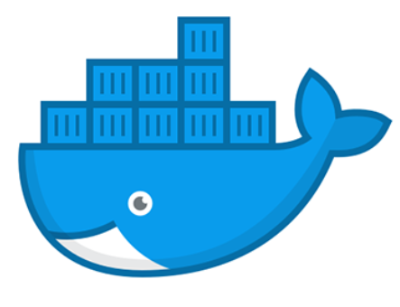
DOCKER

Slide 2
DEEPTHI R
(20PW08)

Slide 3
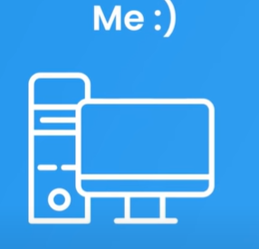
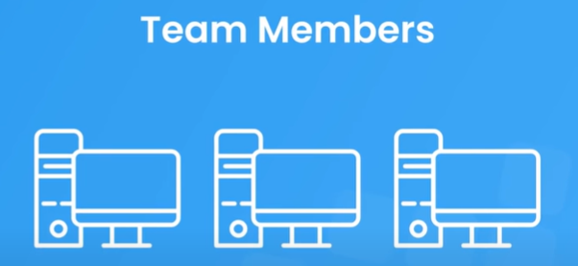
What is Docker?
Docker is a centralized platform for packaging, deploying, and running applications.
Docker helps developers to develop applications easily, ship them into containers, and can be deployed anywhere.

Slide 4
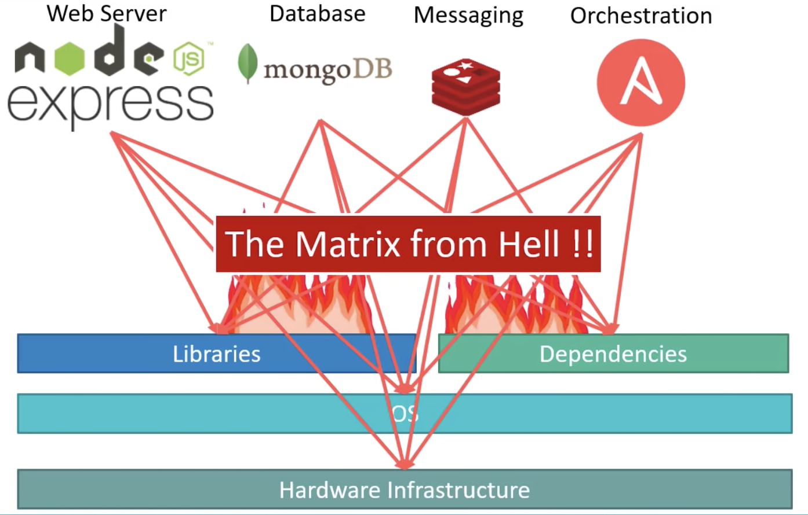
Scenario before Docker
Compatibility / dependency
Long setup time
Different dev / test / prod environments
Matrix from Hell
Describes the set up the development
stack required to build an end-to-end
application.

Slide 5
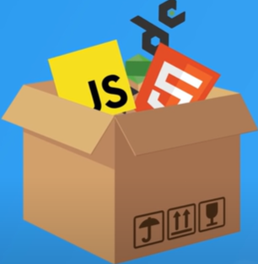
Docker to the rescue!
Docker uses container on the host's operating system to run applications.
It allows applications to use the same Linux kernel as a system on the host computer, rather than creating a whole virtual operating system.
Containers ensure that our application works in any environment like development, test, or production.

Slide 6
Why Docker?
Docker allows us to easily install and run software without worrying about setup or dependencies.
Developers use Docker to eliminate machine problems, i.e. "but code is worked on my laptop." when working on code together with co-workers.
Operators use Docker to run and manage apps in isolated containers for better compute density.
Enterprises use Docker to securely built software delivery pipelines to ship new application features faster and more securely.

Slide 7
Key Features
Easy and Faster Configuration
We can deploy our code in less time and effort. As Docker can be used in a wide variety of environments, the requirements of the infrastructure are no longer linked with the environment of the application.
Increases productivity
By easing technical configuration and rapid deployment of application.
Application Isolation
Each container is independent to another and allows us to execute any kind of application.

Slide 8
Key Features
Swarm
A Docker Swarm is a container orchestration tool running the Docker application. It has been configured to join together in a cluster.
The activities of the cluster are controlled by a swarm manager, and machines that have joined the cluster are referred to as nodes.
Routing Mesh
It routes the incoming requests for published ports on available nodes to an active container. This feature enables the connection even if there is no task is running on the node.

Slide 9
Key Features
Services
Services is a list of tasks that lets us specify the state of the container inside a cluster.
Each task represents one instance of a container that should be running and Swarm schedules them across nodes.
Security
Docker containers are, by default, quite secure; especially if you run your processes as non-privileged users inside the container.
You can add an extra layer of safety by enabling AppArmor, SELinux, GRSEC, or another appropriate hardening system.

Slide 10
Advantages
The environment itself is highly portable and was designed with efficiencies that allow you to run multiple Docker containers in a single environment, unlike traditional virtual machine environments.
The configuration itself can be scripted through a language called YAML, which allows you to describe the Docker environment you want to create. This, in turn, allows you to scale your environment quickly.
The memory usage can be controlled.

Slide 11
Disadvantages
It increases complexity due to an additional layer.
In Docker, it is difficult to manage large amount of containers.
Docker is not a good solution for applications that require rich graphical interface.
Docker provides cross-platform compatibility means if an application is designed to run in a Docker container on Windows, then it can't run on Linux or vice versa.

Slide 12
DHIVYA LAKSHMI S
(20PW10)

Slide 13
WHAT IS A VM?
A VM is a virtual server that emulates a hardware server. A virtual machine relies on the system’s physical hardware to emulate the exact same environment in which you install your applications.
Depending on your use case, you can use a system virtual machine (that runs an entire OS as a process, allowing you to substitute a real machine for a virtual machine) or process virtual machines that let you execute computer applications alone in the virtual environment.
Earlier, we used to create virtual machines, and each VM had an OS which took a lot of space and made it heavy.

Slide 14
DOCKER CONTAINER VS VM
Docker is an open-source project that offers a software development solution known as containers
Containers are compared with virtual machines (VMs). VMs are the guest operating system such as Linux or Windows runs on top of a host operating system with virtualized access to the underlying hardware. Containers allow you to package your application together with libraries and other dependencies, providing isolated environments for running your software services.
VMs have the host OS and guest OS inside each VM. A guest OS can be any OS, like Linux or Windows, irrespective of the host OS. In contrast, Docker containers host on a single physical server with a host OS, which shares among them. Sharing the host OS between containers makes them light
Docker containers are considered suitable to run multiple applications over a single OS kernel; whereas, virtual machines are needed if the applications or services required to run on different OS.
Virtual machines (VMs) are an abstraction of physical hardware turning one server into many servers. The hypervisor allows multiple VMs to run on a single machine. Each VM includes a full copy of an operating system, the application, necessary binaries and libraries – taking up tens of GBs. VMs can also be slow to boot.

Slide 15
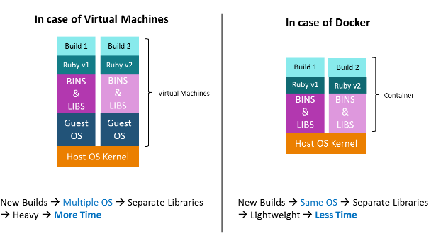

Slide 16
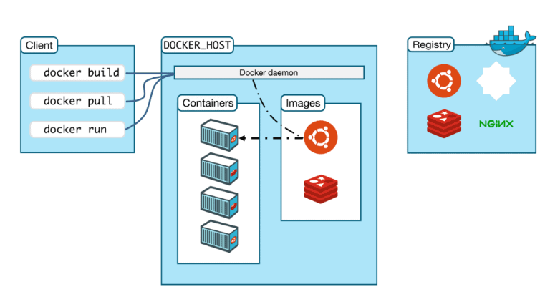
DOCKER ARCHITECTURE

Slide 17
The architecture of Docker uses a client-server model
DOCKER’S CLIENT
Docker users can interact with Docker through a client. When any docker commands runs, the client sends them to docker daemon, which carries them out. It is possible for Docker client to communicate with more than one daemon.
Ex: Docker daemon is the brain behind the whole operation. When you use docker run command to start up a container, your docker client will translate that command into an API call, sends it to docker daemon, Docker daemon then evaluates the request, talks to underlying os and provisions your container.
DOCKER’S HOST
The Docker host provides a complete environment to execute and run applications. It comprises of the Docker daemon & objects- Images, Containers,

Slide 18
DOCKER’S OBJECTS:
1)DOCKER IMAGE
Docker is used to create, run and deploy applications in containers. A Docker image contains application code, libraries, tools, dependencies and other files needed to make an application run.When the image is deployed to a Docker environment, it can be executed as a Docker container.
The docker run command creates a container from a specific image.
Docker images are a reusable asset -- deployable on any host. Developers can take the static image layers from one project and use them in another. This saves the user time, because they do not have to recreate an image from scratch.
So basically Docker images are read only templates that you build from a set of instructions written in Dockerfile. Images define both - what you want your packaged application and its dependencies to look like and what processes to run when its launched.

Slide 19
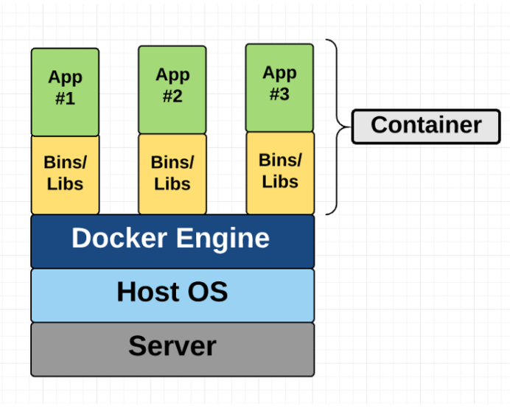
2)DOCKER CONTAINER
A Docker container is a virtualized runtime environment used in application development. It is used to create, run and deploy applications.
This diagram shows you that containers package up just the user space, and not the kernel or virtual hardware like a VM does. Each container gets its own isolated user space to allow multiple containers to run on a single host machine. We can see that all the operating system level architecture is being shared across containers. The only parts that are created from scratch are the bins and libs. This is what makes containers so lightweight.
Containers need a runnable image to exist. Containers are dependent on images, because they are used to construct runtime environments and are needed to run an application.
Containers only have access to resources that are defined in the image.

Slide 20
DOCKER’S REGISTRY
Docker registries are services that provide locations from where you can store and download images.
In other words, a Docker registry contains Docker repositories that host one or more Docker Images.
Public Registries include two components namely the Docker Hub and Docker Cloud. You can also use Private Registries. The most common commands when working with registries include: docker push, docker pull, docker run.

Slide 21

Docker Commands
Cmd : docker - -version
This command returns the version of docker which is installed.

Slide 22
HEMA VARSHIKA V
(20PW11)

Slide 23
Cmd : docker - - help
This command returns a list of commands available in Docker along with the posible flags ( options ) .

Slide 24
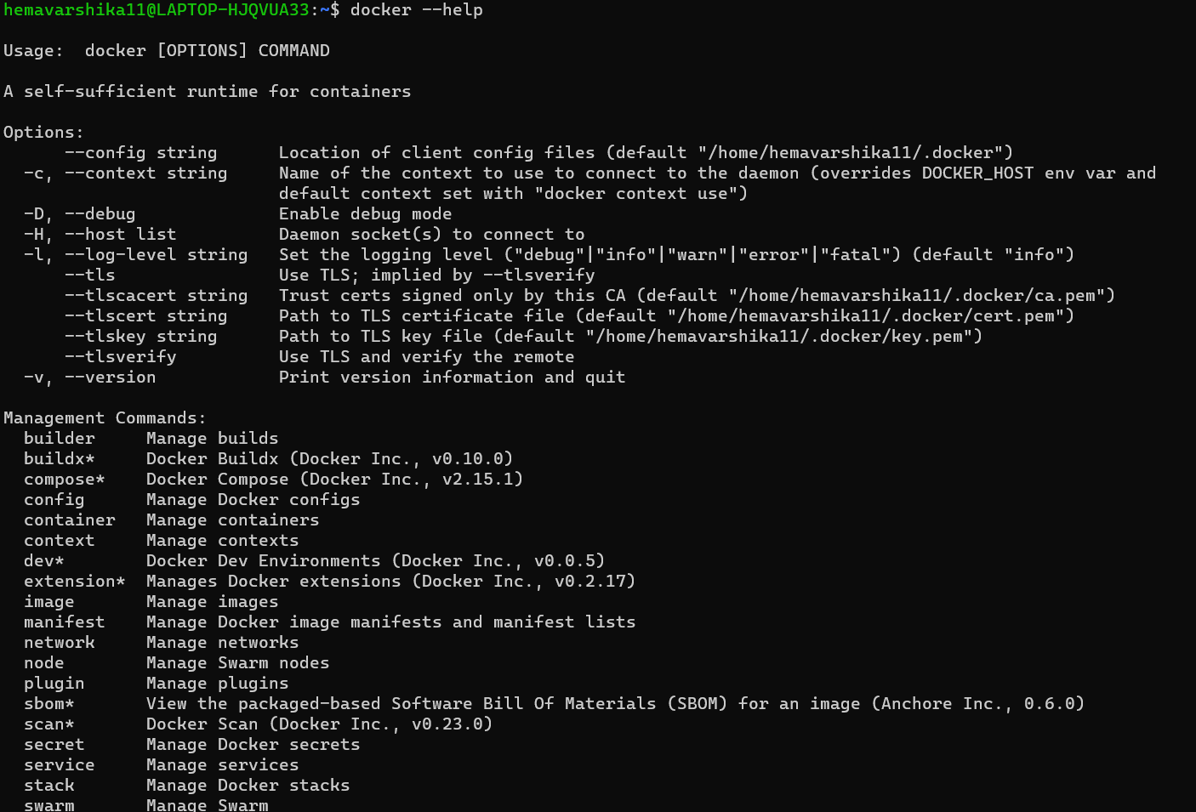
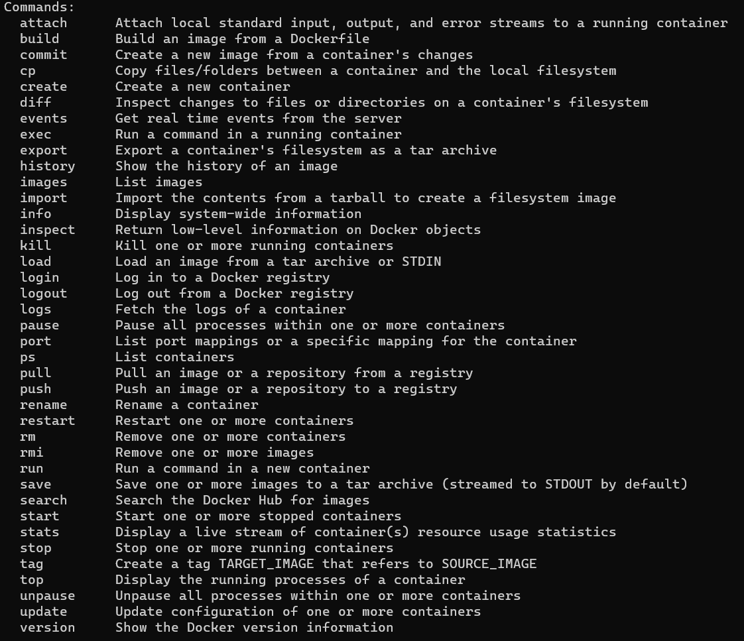

Slide 25
Cmd : docker pull
This command pulls a new Docker image from the Docker Hub.
Cmd :docker images
This command lists down all images in your local repo.
Cmd : docker run
This command executes a Docker image on your local repo and creates a running container out of it.

Slide 26
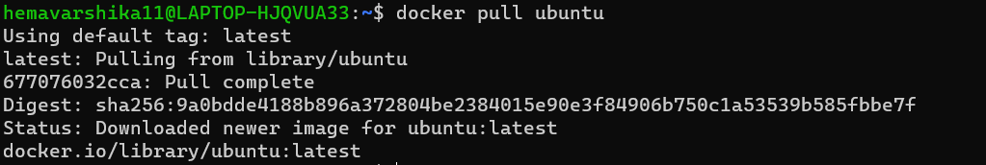
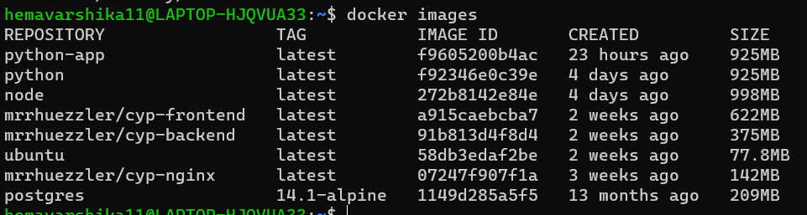

Slide 27
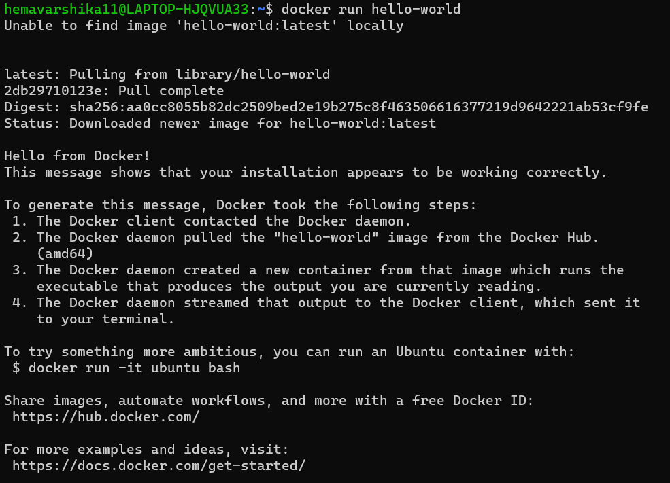

Slide 28
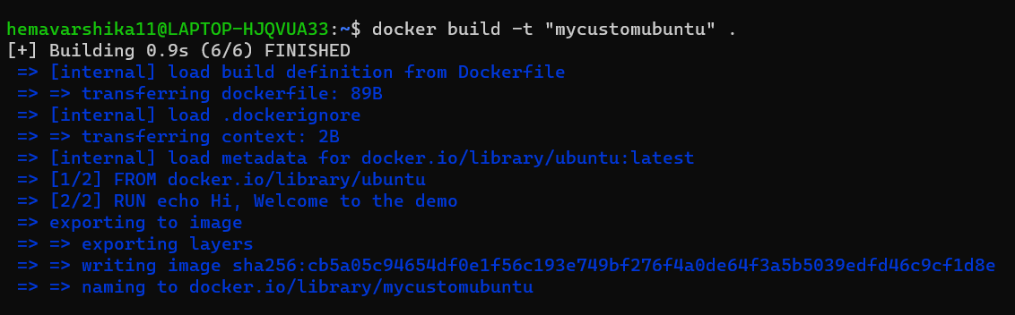
Cmd : docker build
This command is used to compile the Dockerfile, for building custom Docker images based.

Slide 29
Cmd : docker container
This command is used to perform various operations on the container.
docker container logs
docker container kill
docker container rm
docker container run
docker container start

Slide 30
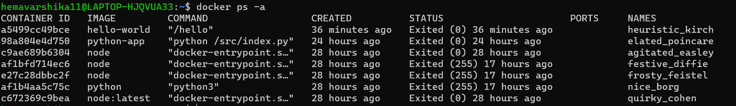
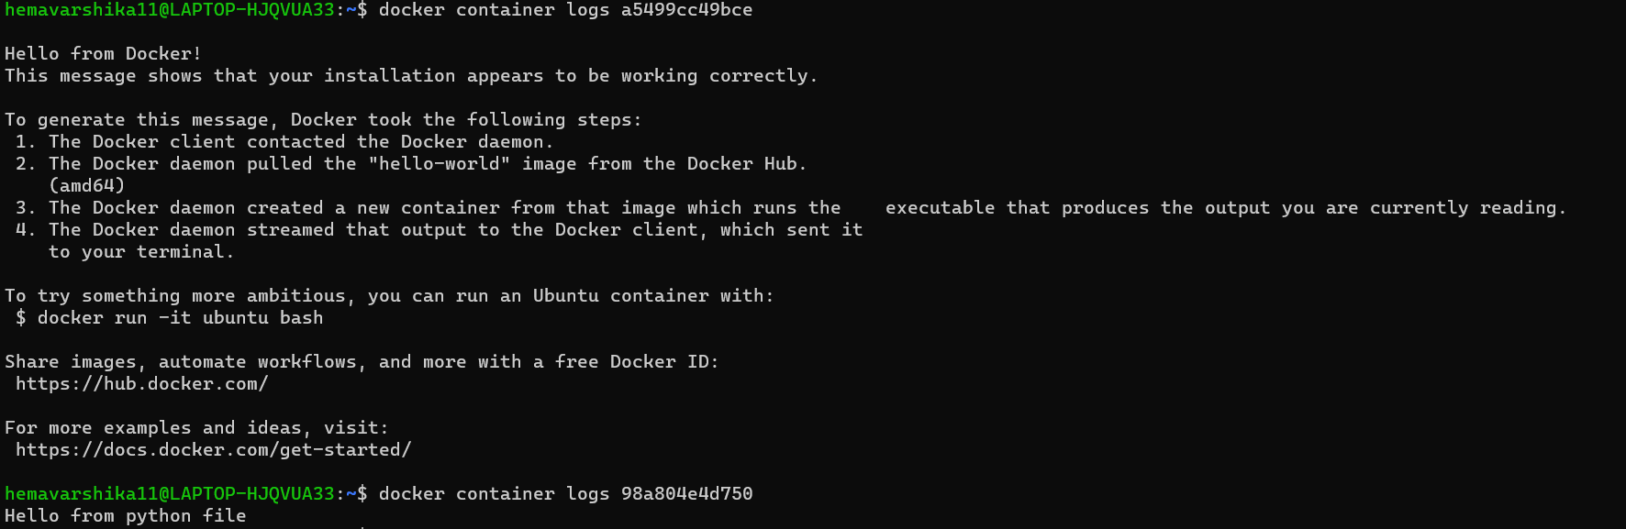

Slide 31
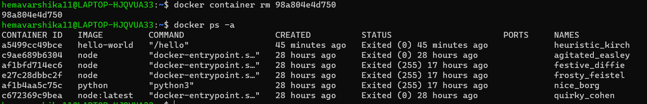

Slide 32
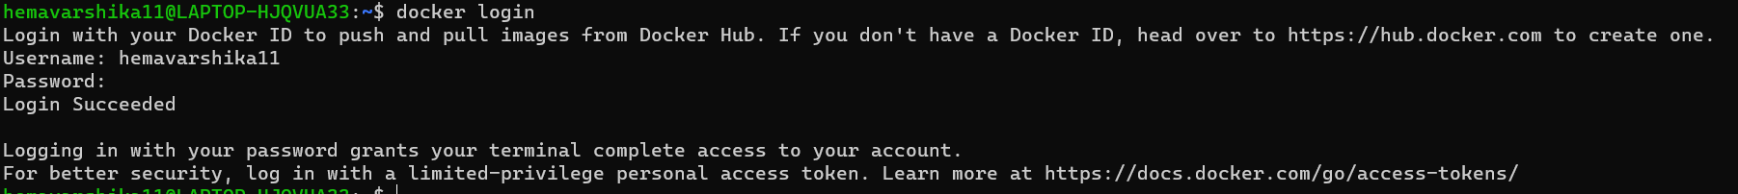
Cmd : docker login
This command is used to Login to Docker Hub from the CLI.

Slide 33
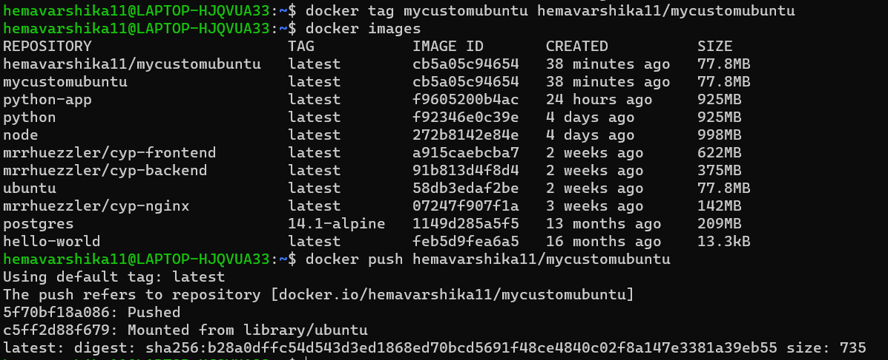
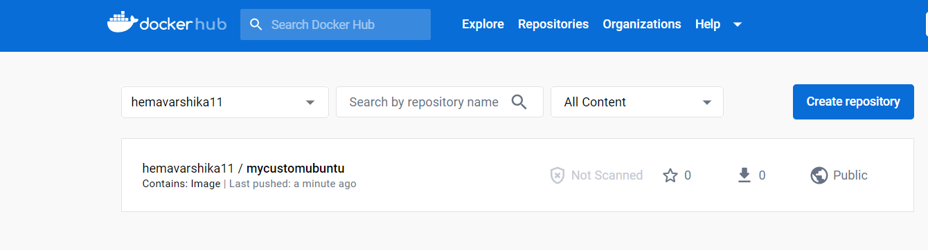
Cmd : docker push dockerid/imagename
This command pushes a Docker image on your local repo to the Docker hub.

Slide 34
Cmd : docker stop
This command shuts down the container whose container ID is specified in arguments. Container is shut down gracefully by waiting for other dependencies to shut.
Cmd : docker kill
This command force kill the running the container

Slide 35
Cmd : docker exec
The docker exec command runs a new command in a running container.
Cmd : docker commit
This command creates a new image of an edited container on the local rep.

Slide 36
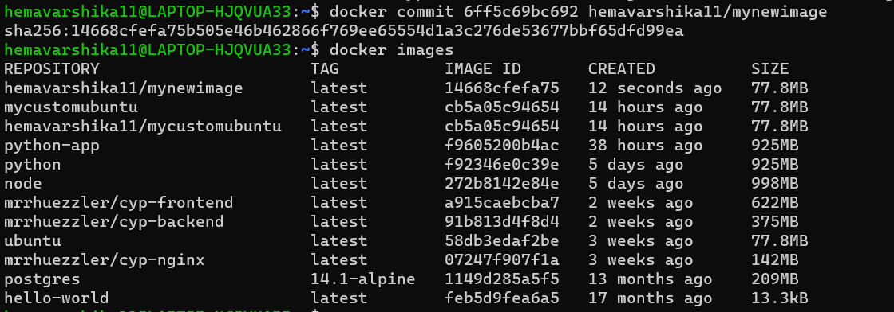

Slide 37
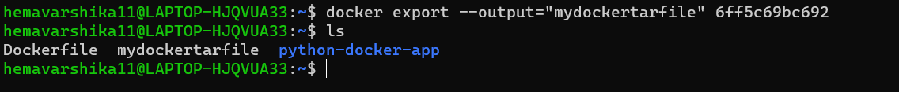
Cmd : docker export
This command is used to export a Docker image into a tar file in your local system.

Slide 38
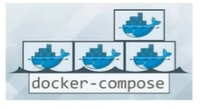
Cmd : docker import
The command is used to import the contents of a tar file( usually a Docker image ) into your local repo.
Cmd : docker compose
This commands is used to power multi-container applications where various services will be hosted inside different containers.

Slide 39
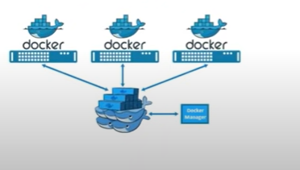
Cmd : docker swarm
This Command created a network of docker engines/hosts to execute containers in parallel ( for scaling up and high availability)

Slide 40
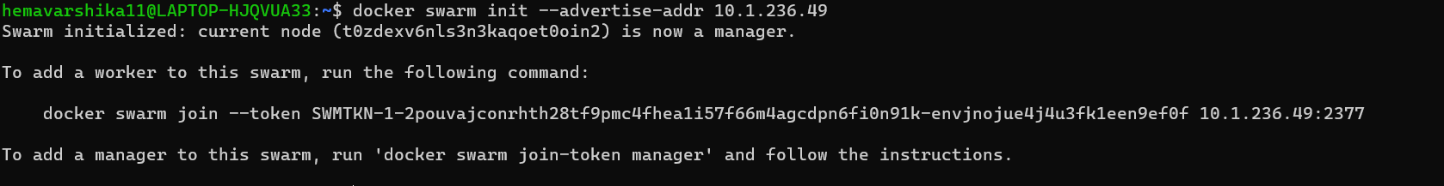

Slide 41
DOCKER COMPOSE
Docker Compose is a tool that was developed to help define and share multi-container applications. With Compose, we can create a YAML file to define the services and with a single command, can spin everything up or tear it all down.

